Slide 1
New Perspectives Portfolio Projects for Soft Skills, 2nd Edition
Project 5: Essential Presentation Skills

Slide 2
Project 5: Objectives
Create and deliver an effective presentation using a four-step process
Apply decision-making steps to presentations
Avoid the most common presentation mistakes
Utilize PowerPoint skills

Slide 3
Project 5: Introduction
Elements of a poor presentation:
Presenter does not know their topic
Presenter has no enthusiasm for their topic
Speaker does not use any visual aids, uses too many, or uses the wrong ones to make their point
PowerPoint slide show is disorganized or looks like the work of a kindergartener
A good presentation can:
Set you apart
Make a positive and memorable impression on your audience

Slide 4
Project 5: Creating and Delivering Effective Presentations
Thoughtful planning can turn an acceptable presentation into a great one
To prepare for your presentation, you should study the following four-step process:
Step 1: Plan
Step 2: Prepare
Step 3: Practice
Step 4: Present

Slide 5
Project 5: Creating and Delivering Effective Presentations (cont’d)
Step 1: Plan
Consider a few key questions to help you plan what to say:
What is the purpose of your presentation?
Who is your audience?
How much time do you have for the presentation?
What kind of visual aids do you require?

Slide 6
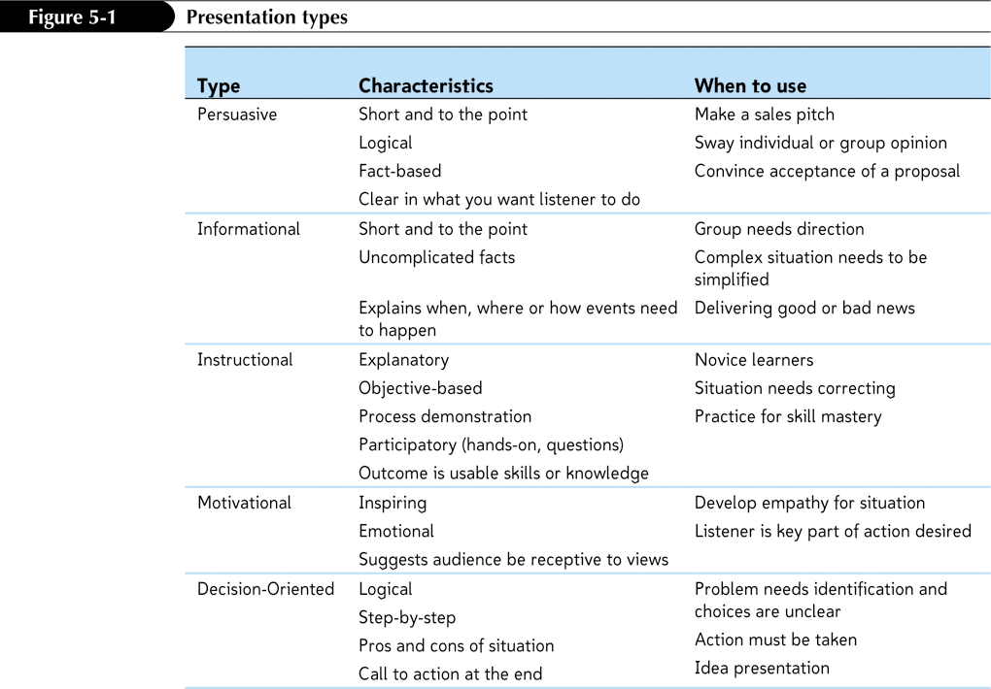
Project 5: Creating and Delivering Effective Presentations (cont’d)

Slide 7
Project 5: Creating and Delivering Effective Presentations (cont’d)
Step 2: Prepare
Know your topic
Outline what you plan to say:
Tell them what you’re going to tell them
Tell them
Tell them what you just told them
Consider the kinds of illustrations, graphics, and audio or video materials needed to support your ideas

Slide 8
Project 5: Creating and Delivering Effective Presentations (cont’d)
Step 3: Practice
Experienced presenters understand that practice may not make them perfect, but it certainly will make them better.
Most knowledgeable speakers practice their presentations to ensure they know:
How the topic flows
What the main points are
How much time to spend on each slide
Where to place the emphasis

Slide 9
Project 5: Creating and Delivering Effective Presentations (cont’d)
Step 4: Present
As you make your presentation:
Relax
Smile
Take your time
Take a few deep breaths at the start.
Make eye contact with members of your audience.
Know that you have done the work to get to this point and you should do fine.

Slide 10
Project 5: Applying Decision- Making Steps to Presentations
Logical and thorough problem-solving processes lead to solid decisions.
You can adapt the steps to making business decisions to organize your presentations:
Step 1: Gather Relevant Information
Step 2: Make Predictions
Step 3: Select the Best Alternative
Step 4: Make an Action Plan
Step 5: Launch and Monitor
Step 6: Check the Results

Slide 11
Project 5: Applying Decision- Making Steps to Presentations (cont’d)
Step 1: Gather Relevant Information
No matter the type of presentation, you’ll want to have all the relevant information at your disposal.
The relevant information might include:
Quantitative financial information such as revenues and expenses
Qualitative factors such as customer opinion surveys or information regarding the economy and legislative action
This information will be useful for the decision itself and can become part of the presentation.

Slide 12
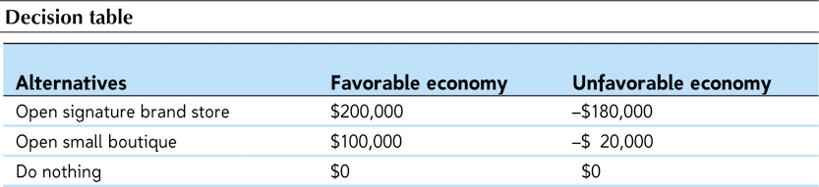
Project 5: Applying Decision- Making Steps to Presentations (cont’d)
Step 2: Make Predictions
A variety of decision-making tools exist to help structure decision processes.
One popular tool is the decision table, which uses probability estimates to help determine the likelihood of certain events.

Slide 13
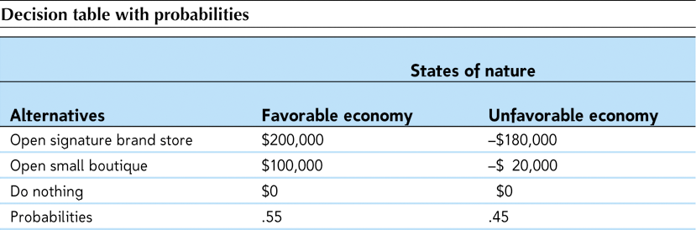
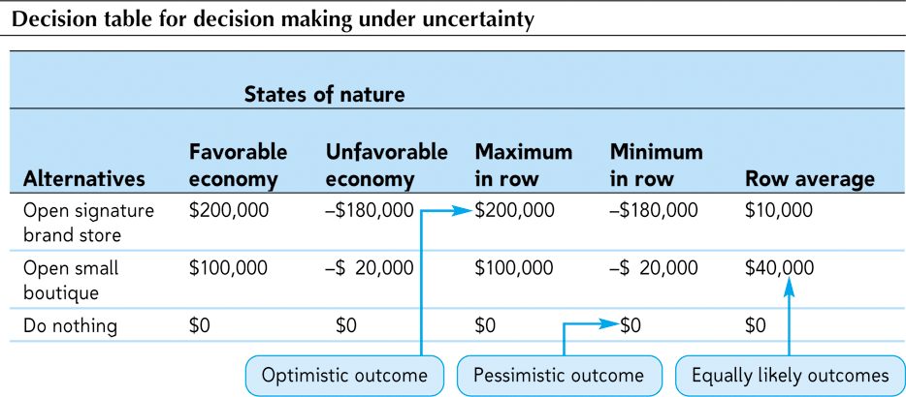
Project 5: Applying Decision- Making Steps to Presentations (cont’d)
Step 2: Make Predictions (continued)

Slide 14
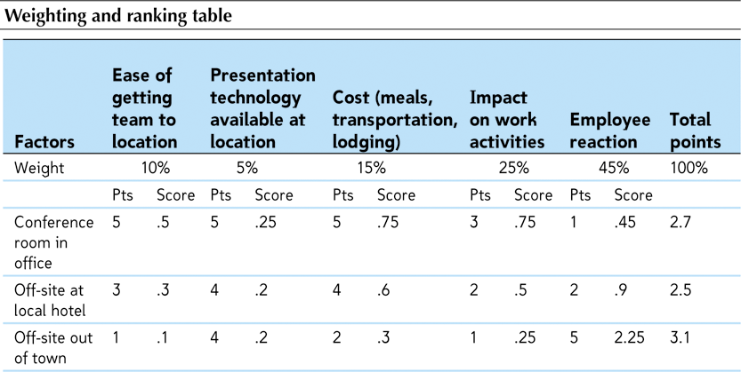
Project 5: Applying Decision- Making Steps to Presentations (cont’d)
Step 2: Make Predictions (continued)

Slide 15
Project 5: Applying Decision- Making Steps to Presentations (cont’d)
Step 3: Select the Best Alternative
Additional questions to ask include:
What qualitative factors need to be considered?
Does this alternative make sense for the long term?
Can you realistically implement the alternative, given the amount of time and resources you have available?
Can you live with the choice even if the outcome is not perfect, or if some unconsidered factors arise after you implement it?
How comfortable are you with the decision?

Slide 16
Project 5: Applying Decision- Making Steps to Presentations (cont’d)
Step 4: Make an Action Plan
Line up the resources—people, finances, equipment, and so on.
Pick someone to manage the implementation so there’s a point person to keep it on budget and on schedule.
Decide how you’re going to manage any human or behavioral issues:
Regular communication
Training schedules
Ways to transition from old to new

Slide 17
Project 5: Applying Decision- Making Steps to Presentations (cont’d)
Step 5: Launch and Monitor
Track progress and make mid-course corrections if something doesn’t go according to plan.
Presentations given during this step include informational status updates, instructional training sessions, and perhaps even motivational talks.
Step 6: Check the Results
Check the accuracy of decisions to see whether you made the right choice.
The results can help you make better decisions the next time.

Slide 18
Project 5: Avoiding the Most Common Presentation Mistakes
Mistake #1: Splitting Up the Presentation
Spend time as a team working through the basic planning and outlining step so all members understand the message.
Mistake #2: Failing to Dress to Impress
An audience’s first impression of a speaker is based on appearance.
Mistake #3: Ignoring Body Language
Research has found that 55% of what we communicate is nonverbal; our voices convey 38% of our meaning; the remaining 7% of our message comes from the words we speak.

Slide 19
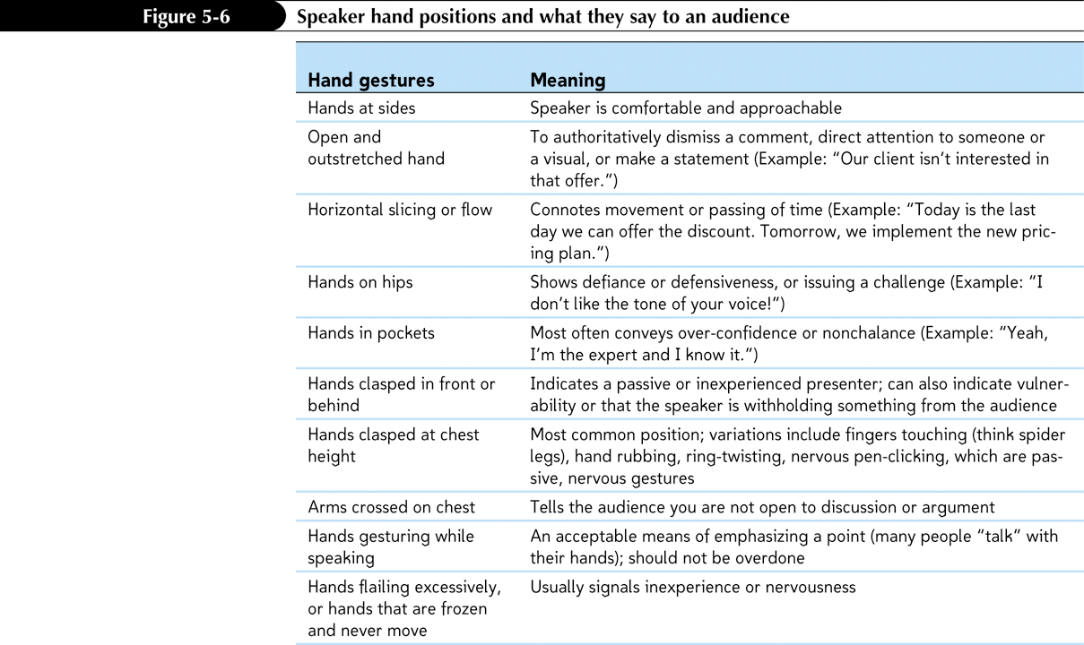
Project 5: Avoiding the Most Common Presentation Mistakes (cont’d)

Slide 20
Project 5: Avoiding the Most Common Presentation Mistakes (cont’d)
Mistake #4: Lacking Passion, Energy, or Authority
If your voice is timid or too soft, the audience will assume you don’t know what you are talking about.
If you speak in a monotone, the audience won’t sense your passion and knowledge of the material.
Mistake #5: Avoiding Audience Involvement
When you involve your audience members in your presentation, they will pay closer attention to what you have to say.
Mistake #6: Using Excessive Non-Words and Fillers
Non-words and fillers are often signs of weakness.

Slide 21
Project 5: Avoiding the Most Common Presentation Mistakes (cont’d)
Mistake #7: Having Technical Difficulties without having a Plan B
Having a backup plan can save the presentation and your reputations.
Arrive at the presentation location early and test out the technology.
Mistake #8: Unnecessarily Distributing Handouts
The audience starts to read through the handouts and gets ahead of the speaker and stops listening.
Instead, distribute a summary of your presentation points at the end of your session.

Slide 22
Project 5: PowerPoint Skills Every Presenter Knows
PowerPoint Dos and Don’ts
Effective use of PowerPoint provides visual presentation support.
PowerPoint is nothing more than a means for organizing a presenter’s speech with visual support.
A well-organized and planned presentation will be enhanced by the judicious use of PowerPoint’s capabilities.
There’s no way PowerPoint can turn a poorly conceived idea into a winning and compelling presentation.

Slide 23
Project 5: PowerPoint Skills Every Presenter Knows (cont’d)
Dos:
Start with a title slide.
Use a consistent theme.
Include only simple and relevant pictures, charts, and graphics.
Use audio cues sparingly.
Use custom animations sparingly.
Layer complex charts, text, or graphics in small groups.
Use simple fonts in a size large enough to be read from the back of the room.
Employ the 7-7 Rule
Press the W or B key to temporarily clear the screen.
Use dark text on a light background.
Tell a good story.

Slide 24
Project 5: PowerPoint Skills Every Presenter Knows (cont’d)
Don’ts:
Don’t skip the titles on each slide.
Don’t layer text on top of a busy background graphic.
Don’t rely solely on the automated spelling and grammar check features.
Don’t overly animate your slides.
Don’t apply strange combinations of colors, themes, fonts, or styles.
Don’t use numbered lists with contents that aren’t in any special sequence.
Don’t display data-intensive charts or graphs.
Don’t create too many slides.
Don’t put too much text on each slide.

Slide 25
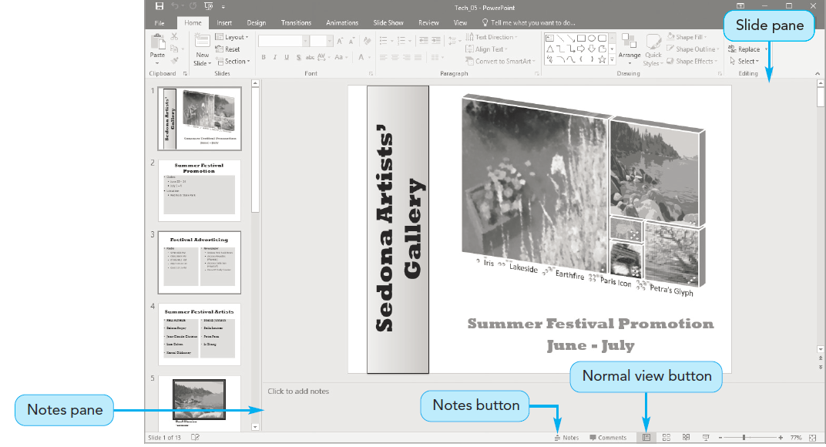
Project 5: Technology Skills—Adding Speaker Notes in PowerPoint Slide Shows and Preparing Handouts
Add speaker notes to a PowerPoint presentation.
Used with permission from Microsoft Corporation

Slide 26
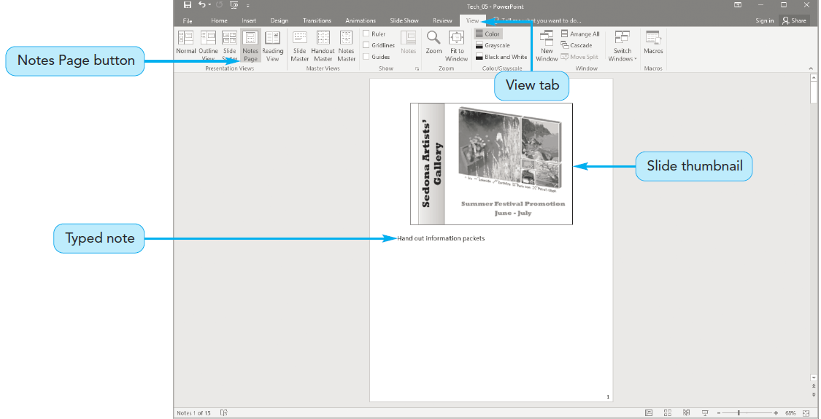
Project 5: Technology Skills—Adding Speaker Notes in PowerPoint Slide Shows and Preparing Handouts (cont’d)
View speaker notes.
Used with permission from Microsoft Corporation

Slide 27
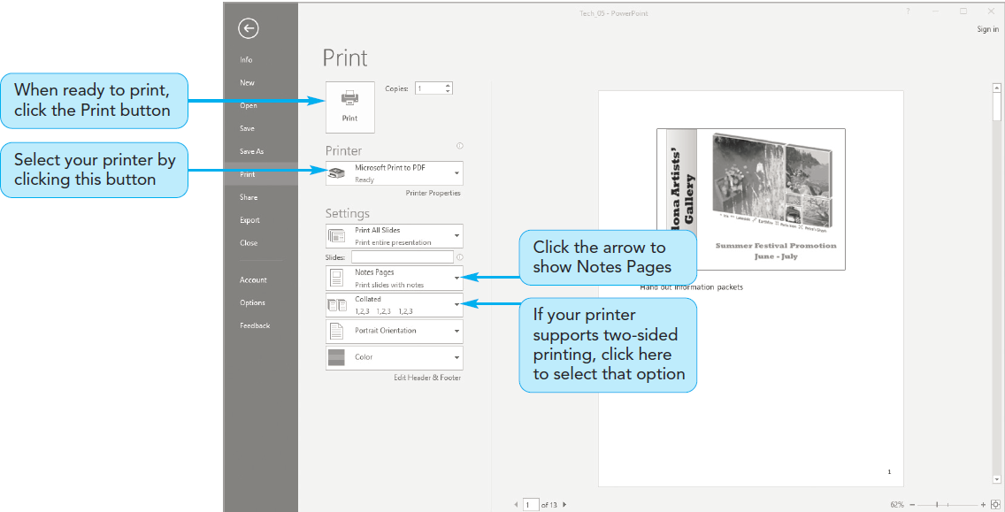
Project 5: Technology Skills—Adding Speaker Notes in PowerPoint Slide Shows and Preparing Handouts (cont’d)
Print speaker notes.
Used with permission from Microsoft Corporation

Slide 28
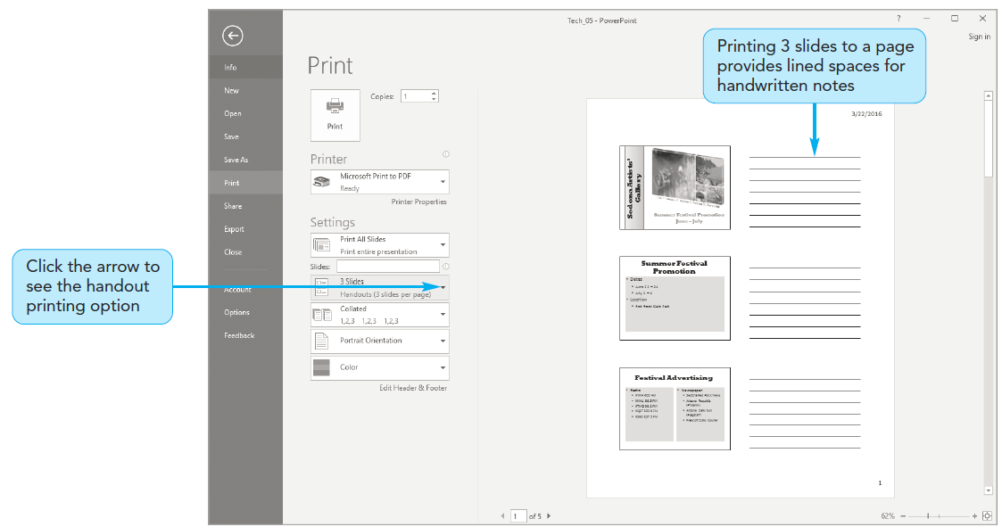
Project 5: Technology Skills—Adding Speaker Notes in PowerPoint Slide Shows and Preparing Handouts (cont’d)
Print audience handouts.
Used with permission from Microsoft Corporation

